Slide 1


DIGITAL TALENT SCHOLARSHIP
2019
AWS Compute Service
digitalent.kominfo.go.id

Slide 2
Contents
AWS Compute Service Overview
EC2
ECS
Lambda
How to Choose?

Slide 3
AWS Compute Overview

Slide 4
Compute Services
Amazon EC2
Virtual machine on AWS
Possible for vertical and horizontal scaling
Payments : on demand, reserved, spot
AWS Lambda
Serverless architecture
No need machine provisioning
Highly scalable

Slide 5
Compute Services
Amazon Lightsail
Service for quick application deployment
Web and applications server for backend
Amazon ECS
Manage containerized application
Bundling applications and libraries on container
AWS Fargate
Allow running containers without managing servers or cluster
Seamless scaling
Amazon EKS
Running containers on Kubernets

Slide 6
What is Amazon EC2?

Slide 7

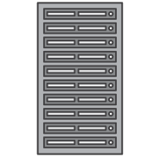

Amazon EC2 – Overview
Virtual Servers in the Cloud
VM 1
VM 2
VM 3
Hypervisor
Server
Physical Servers in AWS Global Regions

Slide 8
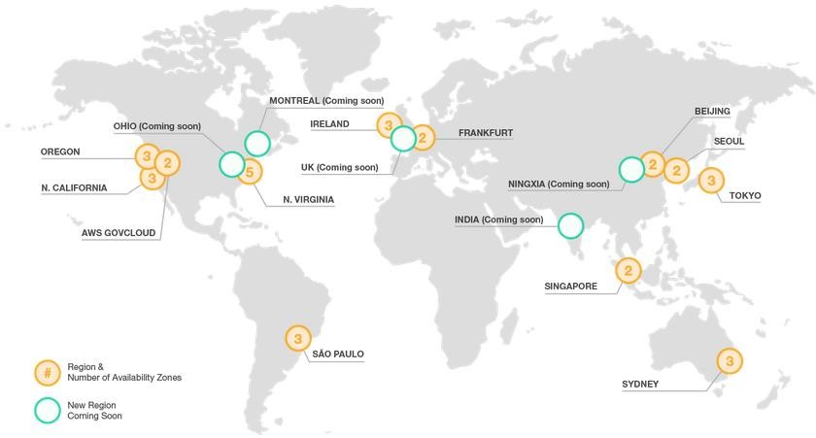
AWS Global Infrastructure
Over 1 million active customers across 190 countries
2,000 government agencies
5,000 educational institutions
17,500 nonprofits
12 regions
33 Availability Zones
*11 more Availability Zones and 5 more Regions coming
online throughout the year

Slide 9

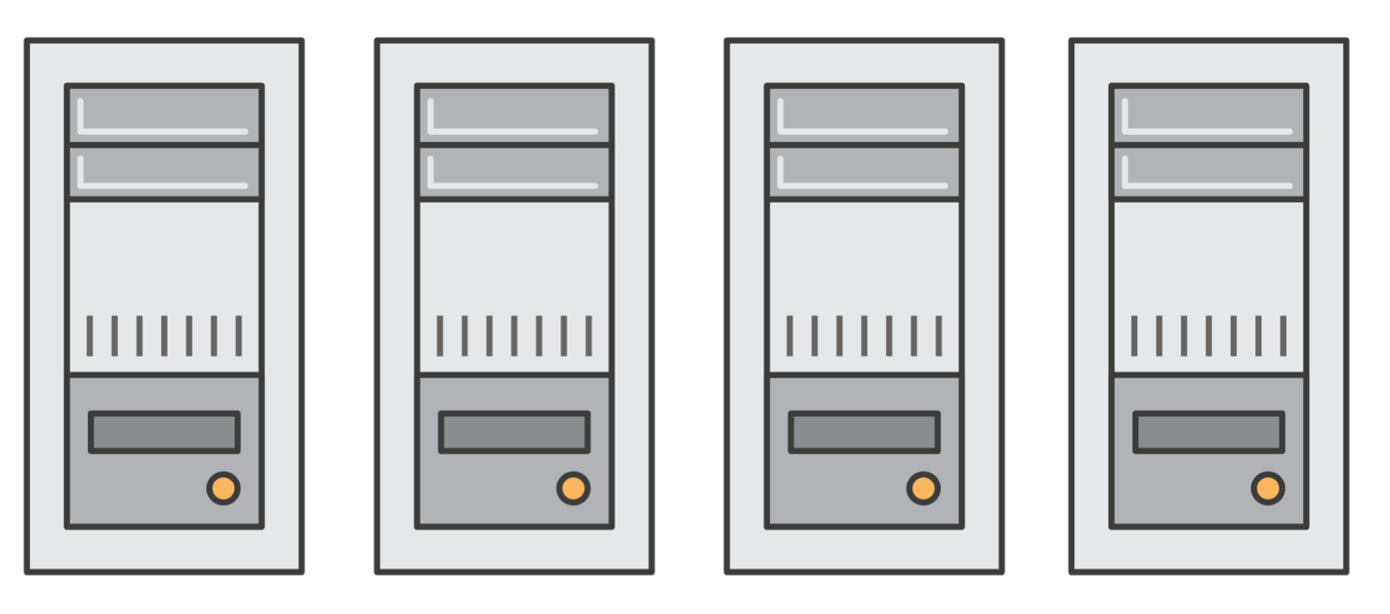
EC2 Use Case
Application Server
Web Server
Database Server
Game Server
Mail Server
Media Server
Catalog Server
File Server
Computing Server
Proxy Server

Slide 10
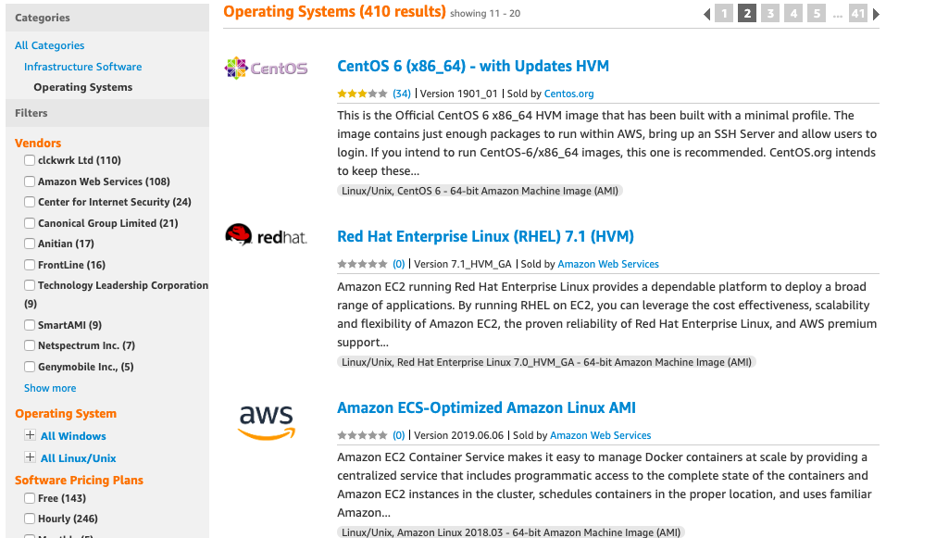
Supported OS

Slide 11
Instance Types
Families | Description | Example Use Cases
t2, m4, m3 | General Purpose Balanced Performance | Websites, web applications, Dev, code repos, micro services, business apps
c3, c4, cc2 | Compute Optimized High CPU Performance | Front-end fleets, web-servers, batch processing, distributed analytics, science and engineering apps, ad serving, MMO gaming, video-encoding
g2, p2 | GPU Optimized High-end GPU | Amazon AppStream 2.0, video encoding, machine learning, high perf databases, science
r3, r4, x1, cr1 | Memory Optimized Large RAM footprint | In-memory databases, data mining
d2, i2, i3, hi1, hs1 | Storage Optimized High I/O, High density | NAS, data warehousing, NoSQL

Slide 12
EC2 Instance Types

Slide 13
Storage Options
Locally attached or “instance storage”
Network attached:
Amazon EBS General Purpose (SSD) volumes
Amazon EBS Provisioned IOPS (SSD) volumes
Amazon EBS Magnetic volumes
Amazon EFS
Amazon S3 and Amazon Glacier for object storage

Slide 14
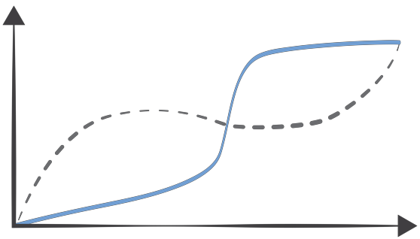
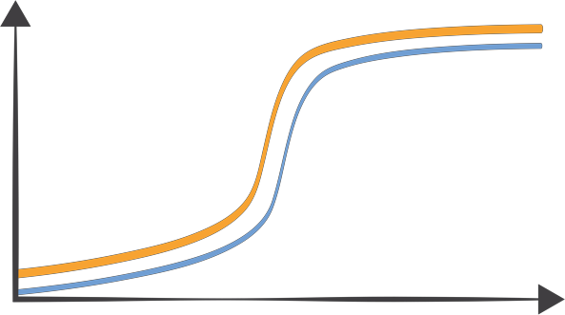
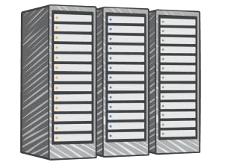

Auto Scaling
Resources scaled to demand
Actual demand
Predicted demand
Actual demand
Waste
Customer dissatisfaction
Rigid on-premises resources
Elastic cloud-based resources

Slide 15

Purchasing Options
On-Demand
Reserved
Spot
Dedicated
Pay for compute capacity by the hour with no long- term commitments
Make a low, one- time payment and receive a significant discount on the hourly charge
Bid for unused capacity, charged at a Spot Price which fluctuates based on supply and demand
Launch instances within Amazon VPC that run on hardware dedicated to a single customer
For spiky workloads, or to define needs
For time-insensitive or transient workloads
For highly sensitive or compliance-related workloads
For committed
utilization

Slide 16




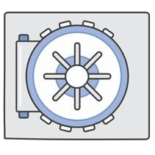
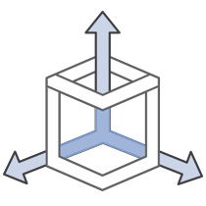
Benefits of Cloud Servers
Fast Deployments Access computing infrastructure in minutes
Low Cost
Pay-as-you-go pricing
Elastic
Easily add or remove capacity
Globally Accessible Easily support customers around the world
Secure
A collection of tools to protect data and privacy
Scalable
Access to effectively limitless capacity

Slide 17
What is Amazon ECS?
Amazon EC2 Container Service (Amazon ECS) is a highly scalable, high performance container management service.
You can use Amazon ECS to schedule the placement of containers across your cluster.
You can also integrate your own scheduler or third-party scheduler to meet business or application specific requirements.

Slide 18
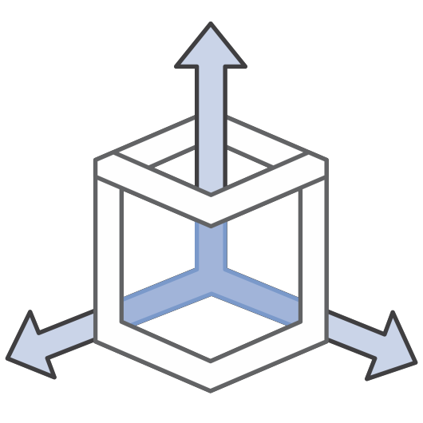
Container Management at Any Scale
Nothing to run
Complete state Control and monitoring scale

Slide 19

Flexible Container Placement
Long running applications
Batch jobs
Multiple schedulers

Slide 20

Integration with the AWS Platform
Elastic Load Balancing
Amazon Elastic Block Store
Amazon Virtual Private Cloud
Amazon CloudWatch
AWS Identity and Access Management
AWS CloudTrail

Slide 21
Compute Evolved – Serverless

Slide 22
What is Serverless?
Operations and Management
Provisioning and Utilization
Scaling
Availability and Fault Tolerance

Slide 23
Benefits of Serverless
Simple
Scalable
Low Cost
Reliable
Low Latency

Slide 24
What is AWS Lambda?
AWS Lambda lets you run code without provisioning or managing servers.
You pay only for the compute time you consume - there is no charge when your code is not running.
Just upload your code and Lambda takes care of everything required to run and scale your code with high availability

Slide 25









Using AWS Lambda
Bring your own code
Node.js, Java, Python
Bring your own libraries (even native ones)
Simple resource model
Select power rating from 128 MB to 1.5 GB
CPU and network allocated proportionately
Reports actual usage
Flexible authorization
Securely grant access to resources, including VPCs
Fine-grained control over who can call your functions
Flexible use
Call or send events
Integrated with other AWS services
Build whole serverless ecosystems

Slide 26

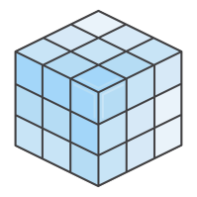


Using AWS Lambda
Programming model
AWS SDK built in (Python
and Node.js)
Eclipse plugin (Java)
Lambda is the “webserver”
Use processes, threads,
/tmp, sockets normally
Authoring functions
Author directly using the console WYSIWYG editor
Package code as a .zip and upload to Lambda or S3
Plugins for Eclipse and
Visual Studio
Command line tools
Stateless
Persist data using Amazon DynamoDB, S3, or ElastiCache
No affinity to infrastructure (can’t “log in to the box”)
Monitoring and logging
Built-in metrics for requests, errors, latency, and throttles
Built-in logs in Amazon CloudWatch Logs

Slide 27


Pay-per Request
Buy compute time in 100 ms increments for 21 microcents
Request charge of 20
microcents
No hourly, daily, or
monthly minimums
No per-device fees
Free Tier
1 million requests and 400,000 GBs of compute every month, every customer

Slide 28
How to Choose

Slide 29
How Do I Choose?
VMs
“I want to configure machines,
storage, networking, and my OS”
EC2
ECS
Lambda
Containers
“I want to run servers, configure
applications, and control scaling”
Serverless
“Run my code when it’s needed”

Slide 30
If You Need to Run…
Open-source cluster management, big data, and database software (e.g., Mesos, Hadoop)
Enterprise applications (e.g., SAP, Oracle, Sharepoint)
On-premises migrations
EC2

Slide 31
If You Need to Run…
Web applications
Docker workloads
Microservices
Batch jobs
ECS

Slide 32
If You Need to Run…
Web applications
Mobile backends
IoT backends
Stream processing workloads
File processing workloads
Lambda

Slide 33
List of Reference
Overview AWS Compute Services
https://docs.aws.amazon.com/whitepapers/latest/aws-overview/compute-services.html
AWS EC2
https://aws.amazon.com/ec2/
AWS ECS
https://aws.amazon.com/ecs/
AWS Lambda
https://aws.amazon.com/lambda/

Slide 34





IKUTI KAMI
digitalent.kominfo
digitalent.kominfo
DTS_kominfo
Digital Talent Scholarship 2019
Pusat Pengembangan Profesi dan Sertifikasi
Badan Penelitian dan Pengembangan SDM
Kementerian Komunikasi dan Informatika
Jl. Medan Merdeka Barat No. 9
(Gd. Belakang Lt. 4 - 5)
Jakarta Pusat, 10110
digitalent.kominfo.go.id

